Slide 1
THE SIMILARITY DIMENSION OF MEANING: DANGERS TO ECOLOGY; ANTIDOTES IN LITERATURE
Andrew Goatly, Honorary Professor, Lingnan University, Hong Kong (apgoatly@gmail.com)

Slide 2
OUTLINE OF LECTURE
2 dimensions of meaning: similarity and contiguity, metaphor and metonymy
Nouns and Verbs/Clauses
Language acquisition: from contiguity in action genres to academic abstraction
Similarity, classification and mathematics
Similarity, money and commodification
Resisting over emphasis of similarity and the illusion of permanence in Literature
Inevitability of the similarity dimension: metaphors for the earth.
(Goatly 2022)

Slide 3
2 dimensions of meaning: similarity and contiguity, METAPHOR AND METONYMY

Slide 4
Saussure: paradigm and syntagm
The “father” of modern linguistics, Ferdinand de Saussure (1960), distinguished the paradigmatic axis and the syntagmatic axis of language.
The paradigmatic axis: the choices we make in using language, e.g., which nouns to put in the blank in “Amanda ate the ______.”
The syntagmatic axis: the way we combine these choices to make text.
The choice is from the paradigms of words that are similar in word-class and semantics – in the sentence above typically nouns referring to types of food
The words combined in syntax will be next to each other or contiguous.

Slide 5
Brain damage, aphasia and Jakobson’s theory: similarity and contiguity
Jakobson used this distinction to highlight basic differences in ways of making meaning or discourse.
“The development of a discourse may take place along two different semantic lines: one topic may lead to another either through their similarity [paradigmatic] or through their contiguity [syntagmatic]. The metaphoric way would be the most appropriate term for the first case and the metonymic way for the second, since they find their most condensed expression in metaphor and metonymy respectively” (1987: 10). [my insertions]
Evidence for this distinction in research into two kinds of aphasia, language impairments arising from brain injury to
Wernicke’s area (in the temporal lobe): deficiencies in the paradigmatic selection axis, in similarity dimension (metaphor)
Broca’s area (in the posterior inferior frontal lobe): deficiencies in the syntagmatic combination axis, in contiguity dimension (metonymy)

Slide 6
Contiguity and Broca’s area, Similarity and Wernicke’s area

Slide 7
2 kinds of Aphasia
“Every form of aphasic disturbance consists in some impairment … of the faculty either for selection and substitution or for combination and contexture. …. The relation of similarity is suppressed in the former [Wernicke’s area], the relation of contiguity in the latter type of aphasia [Broca’s area]. Metaphor is alien to the similarity disorder, and metonymy to the contiguity disorder” (Jakobson 1987: 9-10) [my addition in brackets]

Slide 8
Examples of deficiency/compensation
Broca’s aphasia patients:
“Spyglass” for “microscope” or “fire” for “gaslight”
compensate using the similarity dimension—gaslight is a kind of fire
Wernicke’s aphasia patients:
“fork” for “knife and fork”, “table” for “table lamp”, “eat” for “toaster”
compensate using the contiguity dimension: text or action genre

Slide 9
Language, Meaning Processing And The Two Areas Ardila & Rosselli (1994), Damasio & Tranel (1993), Raichle (1994), Rizzolati & Arbib (1998), Ardila (2010) cf. Also The Master and his Emissary McGilchrist (2019)
BROCA’S AREA | WERNICKE’S AREA
SYNTAGMATIC AXIS | PARADIGMATIC AXIS
CONTIGUITY | SIMILARITY
METONYMY | METAPHOR
VERBS + GRAMMAR | NOUNS

Slide 10
What do we mean by similarity and contiguity?
Similarity is the sharing of features. So, classifications, metaphors, superordinate-hyponym relations (e.g. ‘bird’ – ‘penguin’) depend upon it.
Contiguity means contextuality and, as well as co-text, context is often one of action genres. Literally it depends upon “touching” including relationships such as part to whole, place to object/event /person in that place. But also, by extension, time to object/person/event at that time, and cause and effect. Metonymy depends upon these relationships.
Cause and effect relationships take us beyond local contiguities of action genres to consider global contiguities, e.g. chaos theory and butterfly flapping its wings.

Slide 11
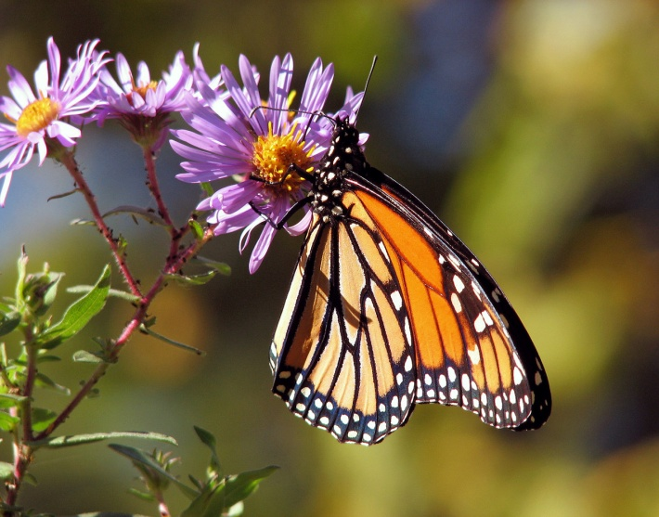
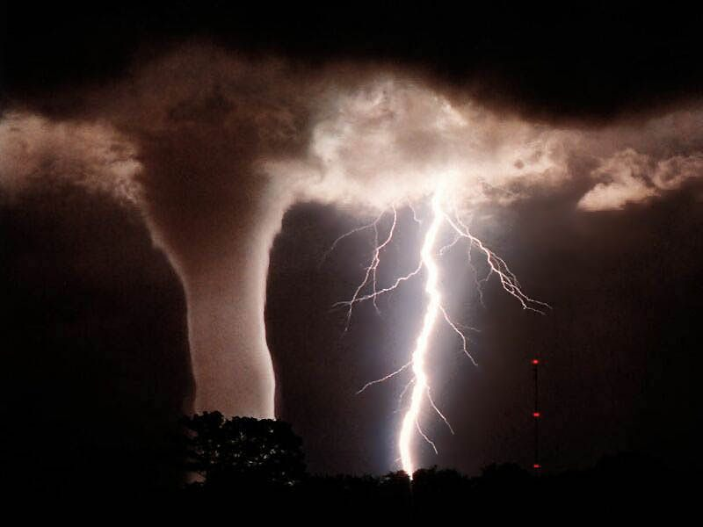
Global Contiguity: Chaos Theory
When a system is far from equilibrium, with stability at risk, then an event can have a causal effect producing another event apparently non-contiguous with it.
The famous example is the idea that a butterfly flapping its wings in Brazil might cause a tornado in Texas, or, at least, help determine its course.

Slide 12
Similarity and contiguity in defining metaphor and metonymy
A metaphor or metonymy occurs when a unit of text (the source term) is used with an unconventional meaning (the target).
In metaphor this unconventional meaning is understood on the basis of similarity between source and target (Goatly 2011)
In metonymy this unconventional meaning is understood on the basis of contiguity between source and target. (Goatly 2022)
Metaphor e.g. The past is a foreign country. They do things differently there. (L. P Hartley (1973) The Go-between)
Metonymy e.g. The doorways were screaming with laughter (Golding 1961 Free Fall: 20) ‘The people in the doorways’

Slide 13
Nouns and Verbs/Clauses

Slide 14
Nouns and Verbs (cf. Langacker 1991)
Entity status | Object | Energetic Interaction
Word Class | Noun | Verb
Instantiated | In space | In time
Extension | Spatially compact Temporally unbounded | Temporally compact Spatially unbounded
Autonomy/Dependence | Autonomous (similarity) | Dependent (contiguity)
Processing | Wernicke’s area | Broca’s area

Slide 15
Verbs, process, contiguity, and contextualisation
Lexical words Grammatical/function words
Noun → verb/adjective → adverb preposition → pronoun → aux verb → article
Verbs less stable in meaning than nouns (fewer types, more tokens than nouns)
Refer to processes that are impermanent
Dependent (In English).
More useful for contextualisation
function in clauses with participants
material process clauses reflect action genres and the contiguities of context
Clauses designed for contextualisation, e.g.

Slide 16
Verbs/Clauses reflecting contiguity
Time Circumstance | Actor | Material process | Goal | Place Circumstance
Yesterday | I | fried | the chicken | on the new gas burner
 | 1
3 |  | 4 |  | 2
Remember Broca’s area associated with clause as well as verb processing:
The material process verb establishes a relationship between participants, Actor and Goal, a syntagmatic contiguity reflecting the contiguities or context of a real action genre – cooking.
The Place Circumstance fills in another aspect of context.
The Time Circumstance fills in another aspect of context.
The tense also locates the action in a time prior to utterance.

Slide 17
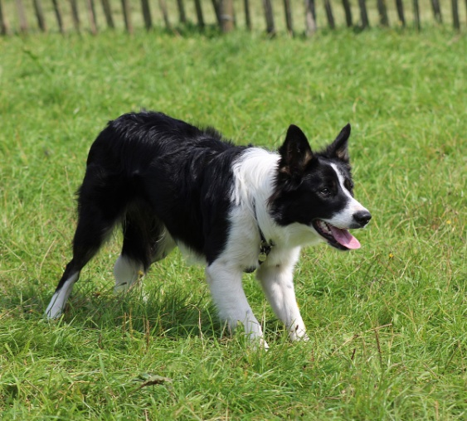
Nouns, similarity, classification, abstraction and permanence
Stable meaning for “stable” object.
Independent
More useful for classification
Longer hyponymic chains:
border collie -- collie – dog – mammal – vertebrate – animal
(contrast verbs shorter hyponymic chains: march – walk – move )
Classification and similarity
Sharing features: collies have all the defining features of dogs, dogs have all the defining features of mammals, etc. etc.
Noun phrases designed for classification and sub-classification

Slide 18
Noun phrases reflecting similarity
deictic | numerative | epithet | classifier | thing
those | two | black | diesel | trains
Exercise 1:
Which elements of this noun phrase are primarily involved in classification and sub-classification

Slide 19
Noun phrases reflecting similarity
deictic | numerative | epithet | classifier | thing
those | two | black | diesel | trains
 | 4 | 3 | 2 | 1
Elements of noun phrase involved in classification and sub-classification
Common nouns assign things to a category or class
Classifiers sub-classify that class
Some epithets (objective) sub-classify the sub-class further
Once classified they can be counted, 4.

Slide 20
Nouns and abstraction
Because by classification they ignore individual properties, noun categories always involve abstraction. (contrast proper names)
But this is much more pronounced when entirely abstract nouns, often nominalisations, are used in science and technology: e.g. growth, rate, magnitude, force, acceleration.
e.g.“Glass crack growth rate is associated with stress magnitude”
The abstract terms are nouns and can then be quantified or measured in mathematical terms or become part of abstract algebraic formula: e.g. F = ma (Force = mass multiplied by acceleration). Algebra is the most abstract of the branches of mathematics– similarity taken to extremes.
Also associated with abstract time e.g. rate, acceleration

Slide 21
Nouns and the illusion of permanence
“It is not possible in relativity to obtain a consistent definition of an extended rigid body, because this would imply signals faster than light. … Actually, relativity implies that neither the point particles nor the quasi-rigid body can be taken as primary concepts. Rather these have to be expressed in terms of events and processes” (Bohm 1980:123-124).
“The best image of process is perhaps that of the flowing stream whose substance is never the same. On this stream one may see an ever-changing pattern of vortices … which evidently have no independent existence as such. Rather they are abstracted from the flowing movement, arising and vanishing in the total process of the flow” (Bohm 1980: 48).

Slide 22
Thing as process

Slide 23
Process and spontaneous change
Natural processes are not controllable as shown by thermodynamics and the theory of entropy
“unlike dynamic objects [i.e. in the Newtonian system of dynamics], thermodynamic objects can only be partially controlled. Occasionally they ‘break loose’ into spontaneous change (Prigogine and Stengers 1985: 120).
Spontaneity of natural systems has even been suggested as the force behind evolutionary change, the saltations, or jumps in the evolutionary record:
“When a system of simple chemicals reaches a certain level of complexity, it undergoes a dramatic transition, akin to the phase change ... when liquid water freezes. The molecules begin spontaneously combining to create larger molecules of increasing complexity… Kauffman argued that this process of self-organisation … led to life… Much of the order displayed by biological systems results ‘not from … natural selection” but from these pervasive order-generating effects. “The whole point of it is that it’s spontaneous order’” (Horgan 1998: 133).

Slide 24
Language acquisition: from contiguity in action genres to academic abstraction

Slide 25
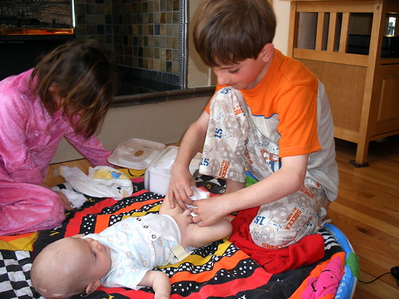
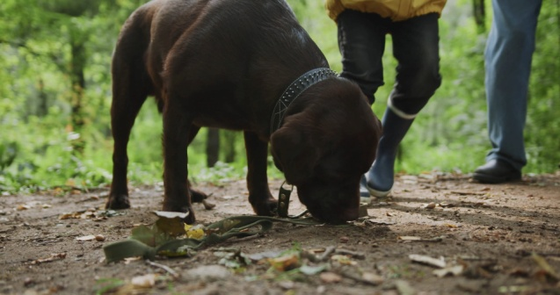
Contiguity: language acquisition in context
A child’s earliest language is acquired during participation in action genres, for instance, eating in the high chair, going for a ride in the car, changing diapers, feeding ducks at the pond, building a block tower, taking a bath, putting away the toys, feeding the dog, going grocery shopping (Bruner 1983).
The infant learns to participate in these action genres by understanding and sharing the purposes of the adult’s actions.
This involves realising what is the most relevant concept at any point in the action genre and therefore the focus of joint attention.
If the adult utters a novel word or phrase, the relevant focus of attention narrows down the likely meaning. If the same word or phrase is used in other genre contexts, what is common to the different contexts will help to narrow the intended referents and messages even further (Tomasello 2008: 156-158).
The commonality is where similarity becomes important

Slide 26
Contiguity: language acquisition in context ctd.
Bruner (1983) -- children have, at base, not a grammar-learning agenda but a socio-interactional one.
Language acquisition is achieved by a process of “pattern detection” in a communicative context rather than by mapping input onto innate grammatical concepts.
Briefly, infants acquire language in action-genre contexts which highlight likely meanings, messages and referents.
The structure of genres involves fundamental cognitive relationships expressed in a specific time period, such as cause and effect, agent and action, patient and action, place and action, all exploiting the contiguity dimension of meaning.

Slide 27
From Speech to Writing-- Exercise 2: verbs and nouns in speech
How many nouns, excluding pronouns, can you identify in this conversation between a mother (MW) and her daughter’s boyfriend (TB)?
TB: Every one else has been talking about marriage but I’m the one that’s getting married. We will get married like you know, we intend to get married and that but not just yet
MW: Don’t get me wrong, I’m not interfering //just want to know what
TB: Oh no oh no
MW: you think about why you don’t want to get married–I mean you’re both over eighteen, nothing I can do, but I don’t like seeing Marion hurt
TB: I don’t want to get married just yet

Slide 28
Speech to Writing, Contiguity to Similarity, Verbs to Nouns
NOUNS IN RED. NOMINALISATIONS UNDERLINED
GRAMMATICAL/FUNCTION WORDS IN BOLD. VERBS IN BLUE.
A.
TB: (1) Every one else (2) has (3) been talking (4) about marriage (5) but (6) I’m (7) the (8) one (9) that (10)’s (11) getting married. (12) We (13) will (14) get married (15) like (16) you know, (17) we intend (18) to (19) get married (20) and (21) that (22) but (23) not just yet
MW: (24, 25) )Don’t get (26) me wrong,(27,28) I’m (29) not interfering (30)I //just want (31) to know (32)what
TB: Oh (33) no oh (34) no
MW: (35) you think (36) about (37) why (38) you (39,40) don’t want (41) to (42) get married–(43) I mean (44) you’re (45) both (46) over eighteen, nothing (47) I (48) can do, (49) but (50) I (51,52) don’t like seeing Marion hurt
TB: (53) I (54,55) don’t want (56) to (57) get married just yet
----------------------------------------------------------------------------------------------------------------------------
B. (1)The great expansion (2) of (3) the use (4) of fertilisers (5) in (6) this century (7) has benefited mankind enormously, (8) but (9) the benefits are (10) not unalloyed. (11) The runoff (12) of chemical fertilisers (13) into rivers, lakes (14) and underground waters creates two important hazards. (15) One is (16) the chemical pollution (17) of drinking water. (18) In certain areas (19) in Illinois (20) and California (21) the nitrate content (22) of well water (23) has risen (24) to (26) a toxic level. Excessive nitrate (27) can cause (28) the physiological disorder methemoglobinemia, (29) which reduces (30) the blood’s oxygen carrying capacity (31) and (32) can be particularly dangerous (33) to children (34) under five.
FUNCTION WORDS (57 IN A, 34 IN B) OFTEN RELATING THE TEXT TO CONTEXT., E.G. DEICTICS, PERSONAL PRONOUNS ETC.

Slide 29
Acquisition of Written Genres: Contiguity and Abstraction Abstraction
Genre | Purposes | Abstraction
 |  | Specific | Time order | Process oriented | Human actor | Factual
DISCUSSION | To present information and opinions about more than one side of an issue: it may end with a recommendation based on the evidence presented | X | X | ? | ? | ?
ARGUMENT | To advance or justify an argument or put forward a particular point of view | X | X | ? | ? | ?
INFORMATION REPORT | To represent factual information about a class of things usually by first classifying them and then describing their characteristics, e.g. encyclopedia entry for an animal | X | X | X | X | √
DESCRIPTION | To represent factual information about a particular place, thing, person or situation, by giving their characteristics, e.g. witness description of a suspect | √ | X | X | X | √
EXPLANATION | To explain why things are as they are or how things work, e.g. encyclopedia entry for photosynthesis | X | √ | √ | X ? | √
PROCEDURE | To show how something can be accomplished through a series or steps of actions to be taken, e.g. recipe | X | √ | √ | √ | X
NARRATIVE | To tell a story in order to make sense of events and happenings in the world | √ | √ ? | √ | √ | X?
RECOUNT | To construct past experience by retelling events and incidents in the order in which they occurred, e.g. diary entry | √ | √ | √ | √? | √

Slide 30
Narrative and the contiguity dimension
Narrative fiction, using Labov’s model of narrative structure (Labov 1972), can be seen as an expansion and repetition of the textual contiguity found in the clause.
Do the contiguities manifest in the clauses and expanded in literary narrative reflect local or global contiguities? The dangers of limiting ourselves to the local contiguities of a specific location and time, with specific individual participants, according to our immediate unaided perceptual experience.
Clause | Narrative
Circumstances of time and place and relational/stative clauses | Orientation
Material, verbal (mental) processes | Complicating Action & Resolution
Participants (actors, goals/patients, sayers, receivers, sensors/experiencers, phenomena/experiences) | Characters

Slide 31
Modern European novels: local contiguity and the betrayal of ecology
Amitav Ghosh’s The Great Derangement: Climate Change and the Unthinkable (2016) laments the modern novel’s restriction to local contiguities:
Fiction “makes possible the imagining of possibilities. And to imagine other forms of human existence is exactly the challenge that is posed by the climate crisis: ….But … this challenge has appeared before us at the very moment when the form of imagining that is best suited to answering it – fiction – has turned in a radically different direction.” (Ghosh 2016: 128–129)
Some problems in contemporary novels are:
(1) limitation to specific places and times, i.e. local contiguities, excludes “forces of unthinkable magnitude that create unbearably intimate connections over vast gaps in time and space” (Ghosh 2016: 63). Contrast epics. The Odyssey ranges over wide spaces, The Ramayana and Chinese folk epic The Journey to the West, over eras and epochs.
(2) separation from the natural world, the planet and its history entailed by “progress” through linear time (cf. Hegel and Marx). Concentrating on the avant-garde erases “every archaic reminder of Man’s kinship with the nonhuman” (Ghosh 2016: 70). During a period of surging carbon emissions “very few of the literary minds [...] were alive to the archaic voice … of the earth and its atmosphere” (Ghosh 2016: 124).
(3) instead of the forces of nature or the social collective, a fixation on individual characters’ moral choices (Ghosh 2016: 77). Ironically, just as we realise “global warming is in every sense a collective predicament, humanity finds itself in the thrall of a dominant culture in which the idea of the collective has been exiled from politics, economics, and literature alike” (Ghosh 2016: 80–81).
Conclusion -- the contemporary novel fails to: consider climate change, pollution and resource depletion; address ecological problems with collective action; imagine a different world that takes into account global and epochal natural forces beyond individual moral choice. Ecology is betrayed by emphasis on the local contiguities of individual experience.

Slide 32
Qualification of Ghosh
MARCO CARACCIOLO (2021): NARRATING THE MESH
The great expanse of time (longue durée) the Great Bay by Dale Pendell
Non-human entities as actors: Being Dead by Jim Crace; Galapagos by Kurt Vonnegut
Metaphorical blurring of human-non-human boundaries: ‘Vaster than empires and More Slow’ by Ursula Le Guin; As She Climbed across the Table by Jonathan Lethem.
Addressing the climate crisis: Oryx and Crake by Margaret Atwood; The Stone Gods by Jeanette Winterson; Solar by Ian McEwan.

Slide 33
SIMILARITY, CLASSIFICATION AND MATHEMATICS

Slide 34
Similarity taken to extremes: mathematics
Once classified, by the noun phrase, objects can be counted/measured (e.g. by numeratives). Qualitative differences are reduced to the quantification of mathematics.
Theoretically, reduction of quality to quantity began with Pythagoras, who found that the note produced by a vibrating string (a quality) depended on the length of the string (quantity).
So “If the ultimate nature of things (quality) depends on mathematical relationships (quantity), then it follows that the world as perceived by our senses must be logical and intelligible as mathematics” (Habgood 2002: 6-7)
Mathematics has been the benchmark for science.
Galileo: “measure what can be measured, and make measurable what cannot be measured” (Gaarder 1996: 203).
“Descartes had a vision of the Angel of Truth who told him that mathematics was the key to unlocking the secrets of nature” (Lent 2017: 235).
Aldous Huxley pointed out, the scientist selects “from the whole of experience only those elements which can be weighed, measured, numbered, or which lend themselves in any other way to mathematical treatment” (Peat 1996: 239).

Slide 35
Mathematics: similarity taken to extremes
Ladder of academic disciplines investigating different kinds of reality:
religious studies (theology)
philosophy
arts and humanities
social sciences
economics
psychology
biology
chemistry
physics
mathematics
Explaining one level in terms of another is distorting “At each stage entirely new laws, concepts and generalisations are necessary… Psychology is not applied biology, nor is biology applied chemistry” (Anderson 1972: 393). And none of the disciplines above it is simply applied mathematics.
From bottom to top: mathematics and God/ultimate truth:
For Roger Bacon, an early Western scientist, maths allowed us to understand the mind of the creator.
Kepler: “What else can the human mind hold besides numbers and magnitudes? These alone we apprehend correctly, and … our comprehension is … the same kind as God's” (Lent 2017: 344-346).
Newton believed by his mathematical laws of motion he was defining God's laws as revealed in the book of nature.
Georg Cantor thought his mathematical study of infinity could prove the existence of God.
(Lent 2017: 350-52).

Slide 36
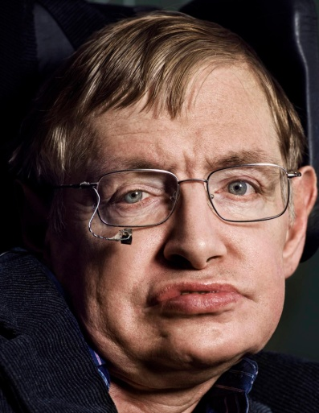
Similarity taken to extremes: mathematics ctd.
In 1998, at the White House, Stephen Hawking made the following prediction:
“We shall have to rely on mathematical beauty and consistency to find the ultimate Theory of Everything. Nevertheless, I am confident we will discover it by the end of the 21st century, and probably much sooner.” (Gleick 2021: 36).
Gleick’s response: “Why should the universe, which grows more gloriously complex the more we see, be reduced to one set of equations and formulae?”
Dangers for ecology. It is distorting to employ numerical models to measure nature, and ecological crises. “Verification and validation of numerical models of natural systems is impossible” since natural systems are always open, making our knowledge of them incomplete, or, at best, approximate, and factoring out the unknown and unmeasurable. These mathematical models might be thought of as “a work of fiction” (Oreskes, Belitz, & Frechette 1994, quoted in Horgan 1998: 202-203).

Slide 37
SIMILARITY AND COMMODIFICATION

Slide 38
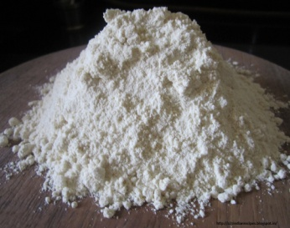
Similarity taken to extremes: money/commodification
Moving from counting to accounting. Equating objects with each other through their monetary value.
e.g. 10 euros, establishes a most abstract category which includes all the goods in their various numbers and quantities that can be bought for 10 euros: 2 metres of X, 12 kilos of Y, or 50 Zs. These quantities of X, Y and Z belong to the same category because they share an identical value of 10 euros.
or or = 10 euros
Market economics maximize efficiency by commodification; as many objects as possible, belonging to noun-based quantifiable classes, are brought into the money-based system. Humans and nature become market commodities, and are exploited/destroyed for profit.

Slide 39
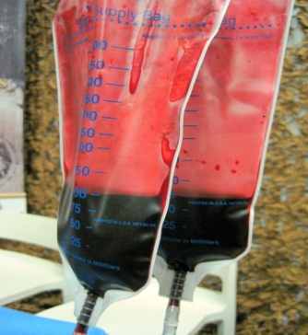
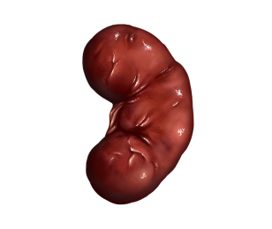
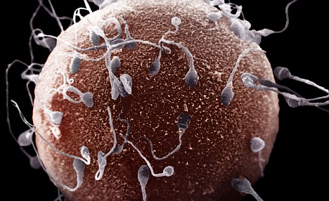
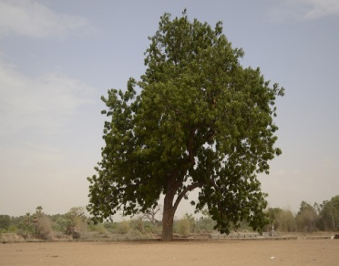
Commodification of humans and nature
Humans: Think of blood bank, organ bank, sperm bank.
Blood → AIDS in rural China, haemophiliacs with AIDS/hepatitis in UK.
Organs. Young men from Moldova and Romania were paid $2,500 for a kidney that would be transplanted into a patient who was paying between $100,000 and $200,000.
Genes. In the US you can make bids of tens of thousands of dollars on the internet for the eggs and sperm produced by glamour models (Habgood 2002: 128). The human genome draft was completed in June 2000. By December there were already 9,364 applications for patents covering 126,672 genes and small sub-gene fragments, increasing at the rate of 34,500 every month.
Nature
Land. The idea of ownership of land was alien to native Americans and Africans before colonisation
Water: privatisation in France and England
Plants: neem tree; Monsanto’s terminator technology

Slide 40
Dangers of commodification
“As Marx noted, money reduces the use values of the multidimensional ecosystem, human desires and needs, and subjective meanings to a common measurable objective standard which everyone can understand” (Harvey 1996: 150-1).
“In the market place, for practical reasons, the innumerable qualitative distinctions which are of vital importance for man [sic] and society are suppressed; they are not allowed to surface. Thus the reign of quantity celebrates its greatest triumphs in ‘The Market’. Everything is equated with everything else. To equate things means to give them a price and make them exchangeable” (Schumacher 1999: 30).
The reductionism of money when allied with mathematically-based technology neglects bio-diversity—pretending difference is unimportant, only monetary value.

Slide 41
Resisting overemphasis of similarity and the illusion of permanence in Literature

Slide 42
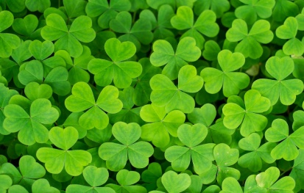
Resistance to classification/similarity--individuation
The medieval philosopher Duns Scotus’
Haeccitas ‘thisness’ -- the features in a particular object that make it different from other members of its class.
“Haeccitas inhered in every created thing, inanimate, animal or human. It was the mark of its Creation by God, and it was active. So it was lived out in action and in movement: each thing veered towards a particular destiny or purpose. This process involved the will, the expression of individuality.” (https://crossref-it.info/articles /187/Inscape-and-instress retrieved 20/12/2020).
Building on Duns Scotus, Gerard Manley Hopkins developed the concepts of inscape and instress.
Inscape is the uniqueness of all natural phenomena, whether leaf, fingerprint, or snowflake. Every individual, including humans, the most fully individuated, actively expresses its identity – “selves”.
Instress is the reciprocal interaction between selving and the human response to it, the reaching out in love to this uniqueness. As a priest, Hopkins believed that instress was a response to the divine, since the individuation of inscape derives from God as creator.

Slide 43
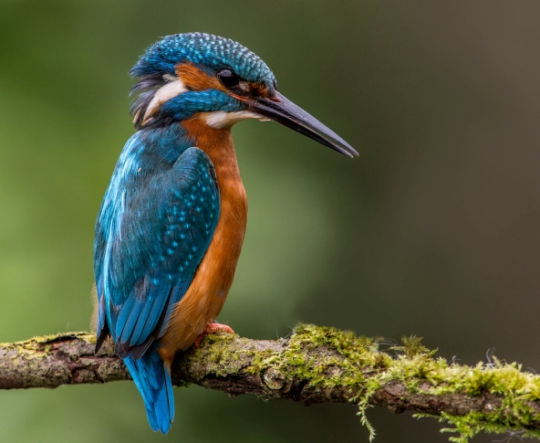
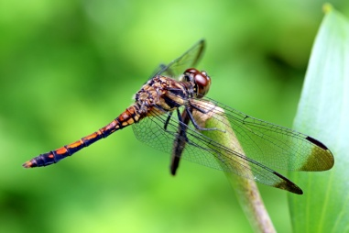
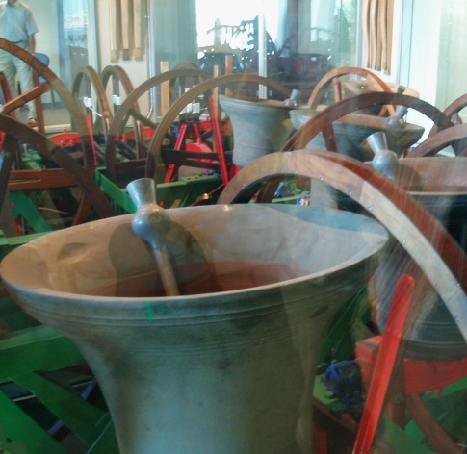
Gerard Manley Hopkins’ ‘As Kingfishers Catch Fire’
As kingfishers catch fire, dragonflies draw flame;
As tumbled over rim in roundy wells
Stones ring; like each tucked string tells, each hung bell’s
Bow swung finds tongue to fling out broad its name;
Each mortal thing does one thing and the same:
Deals out that being indoors each one dwells;
Selves – goes itself; myself it speaks and spells,
Crying Whát I dó is me: for that I came.
I say móre: the just man justices;
Keeps grace: thát keeps all his goings graces;
Acts in God’s eye what in God’s eye he is –
Chríst – for Christ plays in ten thousand places,
Lovely in limbs, and lovely in eyes not his
To the Father through the features of men’s faces.
(Hopkins 1967: 90)
Noun senses inevitably reflect categories, but this poem stresses the “each” and points to the individual uniqueness of every member of the category. Each different plucked string, swung bell, indeed every mortal, impermanent, transitory thing expresses its individuated essence, selves its inscape, thereby fulfilling its divine purpose. Recognising Christ in these selving objects and in the ten thousand different faces or unique features of every human face is the instress response to the divine dynamic creativity.

Slide 44
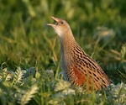
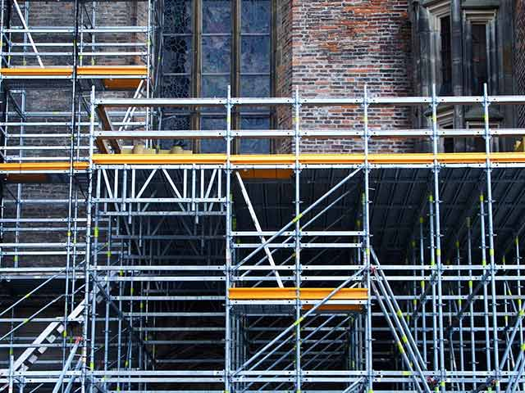
‘Birdsong for Two voices’
Corncrakes https://www.youtube.com/watch?v=cPDOM6rPYNs&ab_channel=WildlifeWorld

Slide 45
‘Birdsong for two voices’ by Alice Oswald. Exercise 3: a) What nominalisations of verbs can you find in this poem? b) Besides these, what other metaphors can you detect in lines 15-24?
a spiral ascending the morning,
climbing by means of a song into the sun,
to be sung reciprocally by two birds at intervals
in the same tree but not quite in time.
a song that assembles the earth 5
out of nine notes and silence.
out of the unformed gloom before dawn
where every tree is a problem to be solved by birdsong.
Crex Crex Corcorovado,
letting the pieces fall where they may, 10
every dawn divides into the distinct
misgiving between alternate voices
sung repeatedly by two birds at intervals
out of nine notes and silence.
while the sun, with its fingers to the earth, 15
as the sun proceeds so it gathers instruments:
it gathers the yard with its echoes and scaffolding sounds,
it gathers the swerving away sound of the road,
it gathers the river shivering in a wet field,
it gathers the three small bones in the dark of the eardrum; 20
it gathers the big bass silence of clouds
and the mind whispering in its shell
and all trees, with their ears to the air,
seeking a steady state and singing it over till it settles

Slide 46
Resistance to thingification: Process in ‘Birdsong for two voices’ by Alice Oswald
a spiral ascending the morning, climbing by means of a song into the sun, to be sung reciprocally by two birds at intervals in the same tree but not quite in time. a song that assembles the earth out of nine notes and silence. out of the unformed gloom before dawn where every tree is a problem to be solved by birdsong. Crex Crex Corcorovado, letting the pieces fall where they may, every dawn divides into the distinct misgiving between alternate voices sung repeatedly by two birds at intervals out of nine notes and silence. | Nominalisation Nominalisation as TRANSITIVE ACTOR—creative material process. Nominalisation as TRANSITIVE ACTOR Nominalisation

Slide 47
Birdsong for two voices, ctd.
while the sun, with its fingers to the earth,
as the sun proceeds so it gathers instruments:
it gathers the yard with its echoes and scaffolding sounds,
it gathers the swerving away sound of the road,
it gathers the river shivering in a wet field,
it gathers the three small bones in the dark of the eardrum;
it gathers the big bass silence of clouds
and the mind whispering in its shell
and all trees, with their ears to the air,
seeking a steady state and singing it over till it settles
metaphor
sun/song (Nominalisation) as TRANSITIVE ACTOR ….
Nominalisations
metaphor
metaphors
……..TRANSITIVE ACTOR.
TRANSITIVE ACTOR

Slide 48
Analysis of ‘Birdsong for Two voices’
Celebration of the power of birdsong.
Birdsong is itself a process, a nominalisation of (birds) sing. If you sing a song, the song (Goal -Range) does not exist independent of the process sing.
As god-like transitive Actor birdsong ‘assembles the earth’ at dawn, solves the problems of the tree, and lets ‘the pieces fall’
Song and sun are blended, phonologically, ‘by means of a song into the sun to be sung’, and because the sun is ‘singing’ as well.
The sun (incorporating the song) too is a powerful transitive Actor: it ‘gathers … instruments … the yard … the sound of the road … the river … silence of clouds … the mind … all trees … bones in the … eardrum’, the last emphasising nature’s power over humans.
Other nominalisations emphasise process—
‘scaffolding’ the assembly/ disassembly of scaffolding that produces sounds, ‘echoes’ and ‘swerving’
Nominalisations of the form –ing. And also present participles: ‘shivering’, ‘whispering’, ‘seeking’ and ‘singing’ suggesting continuing repeated processes.
This poem uses nominalisation to emphasise the process basis, the vibrations as of instruments producing sounds, reflecting post relativity (string) theory.
Additionally the (dis)personifying metaphors fingers, shivering, ears, shell blur the human-nature distinction or suggest parallels between the human and natural worlds.

Slide 49
Exercise 4: How are verbs (and nominalisations of verbs) used in this poem to emphasise process? And what kind of process is predominant? Material, verbal, relational, mental?
As kingfishers catch fire, dragonflies draw flame;
As tumbled over rim in roundy wells
Stones ring; like each tucked string tells, each hung bell’s
Bow swung finds tongue to fling out broad its name;
Each mortal thing does one thing and the same:
Deals out that being indoors each one dwells;
Selves – goes itself; myself it speaks and spells,
Crying Whát I dó is me: for that I came.
I say móre: the just man justices;
Keeps grace: thát keeps all his goings graces;
Acts in God’s eye what in God’s eye he is –
Chríst – for Christ plays in ten thousand places,
Lovely in limbs, and lovely in eyes not his
To the Father through the features of men’s faces.

Slide 50
Process in ‘As Kingfishers Catch Fire’
As kingfishers catch fire, dragonflies draw flame;
As tumbled over rim in roundy wells
Stones ring; like each tucked string tells, each hung bell’s
Bow swung finds tongue to fling out broad its name;
Each mortal thing does one thing and the same:
Deals out that being indoors each one dwells;
Selves – goes itself; myself it speaks and spells,
Crying Whát I dó is me: for that I came.
I say móre: the just man justices;
Keeps grace: thát keeps all his goings graces;
Acts in God’s eye what in God’s eye he is –
Chríst – for Christ plays in ten thousand places,
Lovely in limbs, and lovely in eyes not his
To the Father through the features of men’s faces.
Material process verbs Verbal process verbs Verbal-material Nominalisations

Slide 51
Inevitability of the similarity dimension: metaphors for the earth

Slide 52
Metaphor: diversity in similarity
Metaphors suggests alternative classifications which allow a diversity in ways of thinking and acting. If haeccitas insists on the qualities which are ignored in classification, metaphor’s alternative classifications (Glucksberg and McGlone 1999) may recognise these qualities.
But metaphors may not just highlight qualities in their target, they may attribute features, the source may construct the target.
Harré et al. (1999) discussed various historical European metaphors which construct nature and our interaction with it.

Slide 53
Middle Ages
Nature as a book written by God, for human instruction about the nature of the divine.
The role of humans was to understand the signs in this book, not to rewrite or improve it
Positively suggests something like acceptance not domination (wu-wei), and an openness to nature as sayer or communicator. Cf. “Each mortal thing does one thing and the same …/myself it speaks and spells, /Crying Whát I dó is me.” Inscape. Or the whole of ‘Birdsong for Two Voices’ in which birds are sayers.
Nature is created for humankind and a means of bodily salvation/healing, just like a religious text is a means of spiritual salvation.
Possible negatives: does nature needs to point beyond itself in order to have value? Is the point of nature its value to humans (God)?

Slide 54
The Renaissance
The natural universe (the macrocosm) corresponded to a human body (microcosm) or the state (the body politic). The macrocosm has an intimate cause-effect relationship with the human-body (and human society). Human body and nature reflect each other, e.g. the water cycle is like the circulatory system of blood, e.g. veins of the earth.
Still observable in current English lexis. Personifying natural landscapes, as parts of the human body-- head ‘upper part’ (the head of the valley), fringe ‘edge of an area’, face ‘front slope of a hill or mountain’, mouth either ‘estuary of a river’ or ‘entrance to a cave’, arm / finger ‘promontory’, backbone / spine ‘central row of hills or mountains’, foot ‘lower part’.
Conversely, dispersonifying: grit ‘bravery’, clod ‘stupid person’, flinty ‘severe and hostile (of an expression)’, gravelly ‘rough and low (of a voice)’; contour ‘shape of the body’ (your bikini shows off your contours wonderfully), furrow ‘lines or wrinkles in the forehead (Goatly and Hiradhar 2016).
Positives:
Personifications/dis-personifications, as in ‘Birdsong for two voices’ blur the boundary between the human and non-human, suggesting intimate connection and inseparability
Personification allows environmental destruction to be seen in terms of morality (for example rape of the countryside) (Harvey 1996: 389).

Slide 55
Enlightenment onwards
Nature as a machine – for instance a clock, steam engine or computer.
Two possible positives:
Nature as involved in processes not just a passive thing
Parts of nature are interrelated like parts of a machine.
Otherwise negative and dangerously misleading.
Nature/human body are no longer givens (book/macrocosm-microcosm) but invented.
Machines are created to produce standardised outputs, according to mathematically-based science and technology, and can therefore be understood in mathematical terms. But open biological systems cannot be understood by or reduced to mathematics.
Because machines are made for a purpose they have built in controls, but nature is not controllable – it breaks free or unfolds in spontaneous change (Kaufmann, Prigogine and Stengers).
Machines can be improved and bring about “progress” – so, according to this metaphor, humans can improve nature. However, our technology has not brought ecological progress.
Machines have parts and can be taken apart to see how each operates independently. But nature is a whole and parts of it cannot be ultimately considered separately or valued in isolation (Harvey 1996).

Slide 56
SUMMARY
There is evidence that meaning (in discourse) can develop along two dimensions – similarity/contiguity -- associated with Wernicke’s area and Broca’s area (left and right hemispheres?) respectively.
Nouns/noun phrases tend to reflect similarity, through classification/abstraction, and suggest permanence, while verbs/clauses reflect contiguity and emphasise process and inter-relation.
While spoken language is acquired through immersion in the contiguities of action genres, education – literacy, mastery of academic genres– moves students towards the more abstract, noun-heavy, similarity dimension.
Though narrative involves contiguity and avoids abstraction, recognition of the global contiguities inherent in ecological processes and climate change is often absent in contemporary fiction.
The dangers for ecology in over-emphasis of the similarity dimension are detectable in the hegemony of mathematics over other disciplines, and in the commodification of humans and nature. These abstract reductionisms, allied with technology, may prove fatal to our ecology.
Literature, especially poetry, may counter this over emphasis on similarity -- classification and permanence -- by insisting on individual uniqueness, and recognition of process as basic reality.
Poetry may also deliberately blur the human-nature distinction by personification of nature, often as a sayer/communicator, countering tendencies to separate humans from the contiguous environment.

Slide 57
SUMMARY CTD.
By its nature language depends upon human’s patterning instinct, so it cannot avoid similarity . But it can counter rigid classification by the use of metaphor.
Various dominant metaphors for the natural world are apparent in Western civilisation:
In the Middle Ages the created world was a book revealing the nature of God, with the positive emphasis on the natural world as communicator.
In the Renaissance correspondences were adduced between the macrocosmic universe and humans, positively suggesting an intimate relationship, if not identity, between human and non-human nature, as part of the same larger system.
From the Enlightenment onwards nature has been seen as a machine, with the negative grounds that humans might be thought to invent, control and perfectly understand it, from outside it.
There is no simple equation in which the contiguity dimension is positive and the similarity dimension negative. However, there are real dangers in reductionism by abstraction, technologised mathematics and commodification, the illusion of permanence of objects and categories, and denial of our contiguous belonging within the natural world, all of which arise from over-emphasising similarity.
Might poets as “unacknowledged legislators of the world” resist and counter these dangers?

Slide 58
References
Anderson, P. 1972. More is different. Science, 177(4047): 393-396.
Ardila, A. 2010. A proposed re-interpretation and re-classification of aphasic syndromes. Aphasiology, 24 (3), 363–394 DOI: 10.1080/02687030802553704
Ardila, A., & Rosselli, M. 1994. Averbia as a selective naming disorder: A single case report. Journal of Psycholinguistic Research, 23, 139–148
Bohm, D. 1980. Wholeness and the Implicate Order. London: Routledge
Bruner, J. 1983. Child's Talk:Llearning to Use Language. New York: Norton.
Caracciolo, M. 2019. Narrating the Mesh. Charlottesville and London: University of Virginia Press.
Damasio, A. R., & Tranel, D. 1993. Nouns and verbs are retrieved with differently distributed neural systems. Proceedings of the National Academy of Sciences, 90, 4957–4960.
Gaarder, J. 1996. Sophie’s World. New York: Berkley Books.
Ghosh, A. 2016. The Great Derangement: Climate Change and the Unthinkable. Chicago: University of Chicago Press.
Gleick, J. 2021. Eclipsed by fame. New York Review of Books, 68 (7), 34-36.
Glucksberg, S. & McGlone, M. 1999. When love is not a journey: what metaphors mean. Journal of Pragmatics 31, 1541-1558.
Goatly, A. P. 2011. The Language of Metaphors (2nd edition). Abingdon: Routledge.
Goatly, A. 2022. Two Dimensions of Meaning. Abingdon: Routledge
Goatly, A. P& Hiradhar, P. 2016. Critical Reading and Writing in the Digital Age. London: Routledge.
Habgood, J. 2002. The Concept of Nature. London: Darton, Longman & Todd.
Harre, R., Brockmeier, J. & Muhlhausler, P.. 1999. Greenspeak: A Study of Environmental Discourse. Thousand Oaks, CA: Sage.
Harvey, D. 1996. Justice, Nature and the Geography of Difference. Cambridge Mass.: Oxford.

Slide 59
References ctd.
Hopkins, G. M. 1967. Poems of Gerard Manley Hopkins (4th edition, W.H. Gardner, & N.H Mackenzie, Eds.). London: Oxford University Press.
Horgan, J. 1998. The End of Science. London: Abacus
Jakobson, R. 1987. Two aspects of language and two types of aphasic disturbances. http://www.ieeff.org/jakobsonaphasiafull.pdf PDF from Jakobson, R. 1987. Language in Literature, (K. Pomorska & S. Rudy Eds.), Cambridge MA: Harvard University Press. Pp. 1-12.
Labov, W. 1972. Language in the Inner City. Philadelphia: Philadelphia University Press.
Langacker, R. W. 1991. Foundations of Cognitive grammar, vol. 2: Descriptive Applications. Stanford: Stanford University Press.
Lent, J. 2017. The Patterning Instinct. New York: Prometheus Books.
McGilchrist, I. 2019. The Master and his Emissary. New Haven and London: Yale UP
Oreskes, N., Belitz, K. & Frechette, K.S. 1994. Verification, validation and confirmation of numerical models in the Earth Sciences. Science, February 4, 1994, 641-646.
Oswald, A. 2005. Woods etc. London: Faber.
Peat, D. 1996. Blackfoot Physics: A Journey into the Native American Universe. London: Fourth Estate.
Prigogine, I. and Stengers, I. 1985. Order out of Chaos. London: Flamingo.
Raichle, M. E. 1994. Visualizing the mind. Scientific American, 270, 58–65.
Rizzolatti, G., & Arbib, M. A. 1998. Language within our grasp. Trends in Neurosciences, 21, 188–194.
Saussure, F. de. 1960. Course in General Linguistics, C. Bally, C & A. Sechehaye (Ed.s) W. Baskin (trans.). London: Peter Owen.
Schumacher, E.F.1973/1999. Small is Beautiful: Economics as if People Mattered. Point Roberts WA & Vancouver: Hartley and Marks.
Tomasello, M. 2008. Origins of Human Communication. Cambridge Mass: MIT Press.

Slide 60
Mathematical linguistics: Chomsky, and resistance to Chomsky

Slide 61
Chomsky, mathematics and similarity
Chomskyan paradigm in linguistics tends to emphasise similarity by
Algebraic mathematical generative rules
Claims of linguistic universals

Slide 62
Chomsky and mathematical linguistics
Generational grammar is computational.
S → NP (AUX) VP
John has given Mary the chocolates
NP → (ART) N (S)
The fact that light is both wave and particle
VP → VB (NP) (NP)
given Mary the chocolates
or
VP → VB (NP) (S)
told John these ducks can’t fly
(Jacobs and Rosenbaum 1968)
(S = sentence, NP = noun phrase, AUX = auxiliary verb, VP = verb phrase, ART = article, N = noun, VB = verb. Parentheses indicate optional elements.)

Slide 63
Algebraic predicate logic and semantics
Meaning is formulated in the mathematical algebraic terms of propositional and predicate logic, e.g. the formulae for the meaning ‘All men are mortal’, and the syllogism which follows it.
All men are mortal ∀ x (M(x) → D(x))
Socrates is a man M (a)
Therefore Socrates is mortal ∴ D (a)
(∀ is the universal quantifier, a stands for Socrates, M stands for ‘is a man’ and D stands for ‘is mortal’)
(Palmer 1976: 187)

Slide 64
Resisting mathematical de-contextualised semantics
Besides conceptual or logical meaning Leech suggested:
(1) connotative meaning, what a word means by virtue of what it refers to; e.g. the conceptual definition of ‘dog’, the semantic criteria for literal application, excludes features associated with referents of dog, e.g. [has a tail, barks, has fur, has four legs]
(2) collocative meaning, the associations with words which occur in the same text environment (cf. priming)
(3) thematic meaning; the organisation of the message in terms of order and emphasis, and the distribution of given and new information
(4) affective meaning -- the expression of emotion, e.g. swear words, e.g. bloody, and attitudinal epithets.

Slide 65
Leech’s semantics ctd.
(5) social meaning, elaborated by questions about a linguistic expression: does it tell you?
exactly which individual is speaking (idiosyncrasy)
the speaker’s social class or geographical area they come from (dialects)
the speaker’s age
the speaker’s status and intimacy in relation to their interlocutor
the occupational genre the speaker/writer is participating in
All these, 1 -5 re-instate the contiguities of context.
Connotative meaning (1) reinstates the associations built up over experience of the referential context
collocative meaning (2) and thematic meaning (3) reflect the textual context or co-text
the affective (4) and social (5) account for the interpersonal and cultural context of communication.

Slide 66
Linguistic relativity against Chomsky’s universals– all languages are not similar
Sapir-Whorf hypothesis: linguistic relativity against universalism: Benjamin Lee Whorf, in contrast with Chomsky and followers like Steven Pinker (1994), denied
any kind of universal semantics
the possibility of commensurability/equivalence between meanings in different languages (Whorf 1956: 57-65).
In a weaker form generally accepted:
The vocabulary and grammar of a particular language influence the users of that language to think in certain ways about themselves, other members of society and the world around them.
Speaking one language makes it difficult, but not impossible, to think like the speakers of another language. (Lakoff (1987), Gumperz and Levinson (1991), and Evans and Levinson (2009); in anthropology -- Gordon (2004), Everett (2005), Thierry et al. (2009) etc.

